Slide 1

RESTAU ANALYTICS
https://dieudonne.shinyapps.io/RESTAUANALYTICS
By Dieudonne Ouedraogo
Insight Data Science

Slide 2


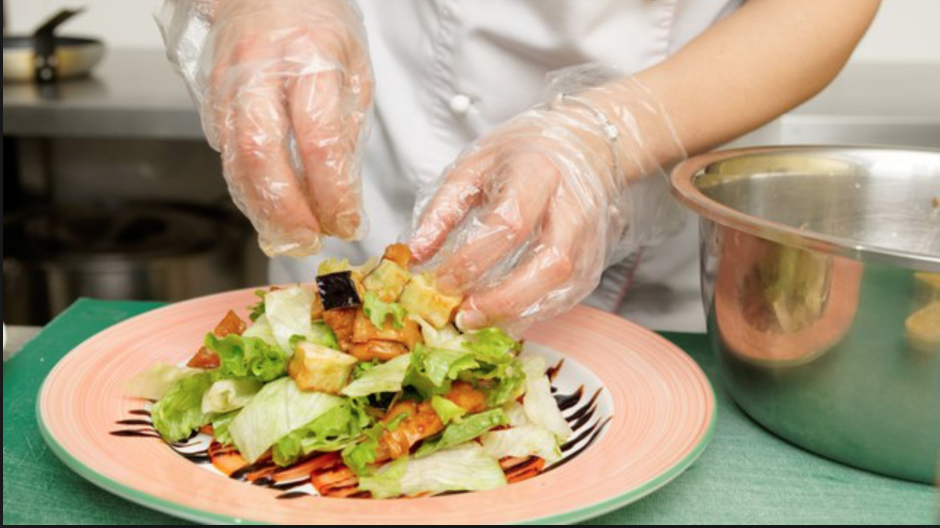

Problem Statement
The Department of Health and Mental Hygiene in NYC inspects restaurants and assigns violation scores to maintain a high standard and prevent diseases through food contamination, but the resources are limited.

Slide 3
Matching the numbers
About 26K Restaurants in NYC
About 100 Inspectors

Slide 4
Violation points, Grades and Regulations
0-13 Points = "A"
14-27 Points = "B"
28+ Points = "C"
3 inspections of 28+
= closing of facilities

Slide 5
The Data
Inspection results from 2010 to 2019
From NYC Open Data
385K Rows, 18 Columns

Slide 6
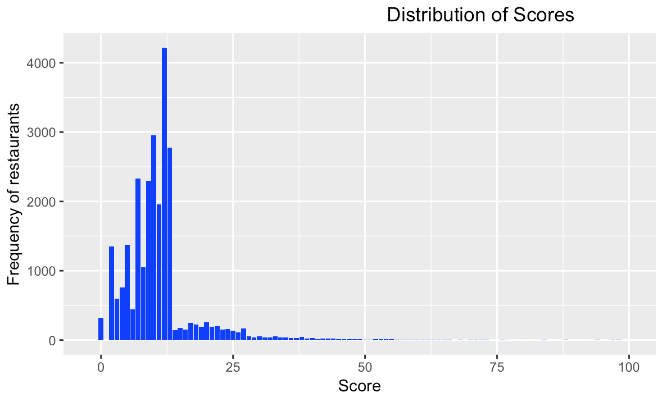
Distribution of Scores

Slide 7
The Math behind: Markov Chain
0-13 Points
"A"
14-27 Points
"B"
28+ Points
"C"

Slide 8
The Priority
0-13 Points
"A"
14-27 Points
"B"
28+ Points
"C"

Slide 9
Data Transformation & Feature Engineering
Raw Data:
385K observations
Processed Data:
25K Observations and new features as past scores

Slide 10

Raw Data
CAMIS | INSPECTION DATE | ACTION | SCORE | GRADE | INSPECTION TYPE
40377630 | 1/17/2014 | Establishment Closed by DOHMH. Violations were cited in the following area(s) and those requiring immediate action were addressed. | 43 |  | Cycle Inspection / Re-inspection
40377630 | 1/21/2014 | Establishment re-opened by DOHMH | 2 | C | Cycle Inspection / Reopening Inspection

Slide 11
Processed Data: Scores features
Inspection 30 | Inspection 31 | Inspection 32 | Inscpection 33 | DBA | BUILDING | STREET | CUISINE.DESCRIPTION | BORO | ZIPCODE
31 | 29 | 7 | 27 | MORRIS PARK BAKE SHOP | 1007 | MORRIS PARK AVE | Bakery | BRONX | 10462
13 | 10 | 12 | 13 | WENDY'S | 469 | FLATBUSH AVENUE | Hamburgers | BROOKLYN | 11225
12 | 20 | 8 | 10 | DJ REYNOLDS PUB AND RESTAURANT | 351 | WEST 57 STREET | Irish | MANHATTAN | 10019
43 | 13 | 10 | 10 | RIVIERA CATERERS | 2780 | STILLWELL AVENUE | American | BROOKLYN | 11224

Slide 12
The Modeling Process
Predict
Predict violation scores
Extract
Extract trends and fluctuations from past
Retrieve
Retrieve high priority cases to inspect

Slide 13

Model used
Random forest regressor
This problem involves correlated and a large number of features, RF has proven to handle this situation well! As a validation during testing, the model indeed achieved the lowest MSE compared to a Linear regression, decision trees, a GBM and a baseline model of carrying previous scores.

Slide 14

Error and Model

Slide 15
The web-app
https://dieudonne.shinyapps.io/RESTAUANALYTICS

Slide 16
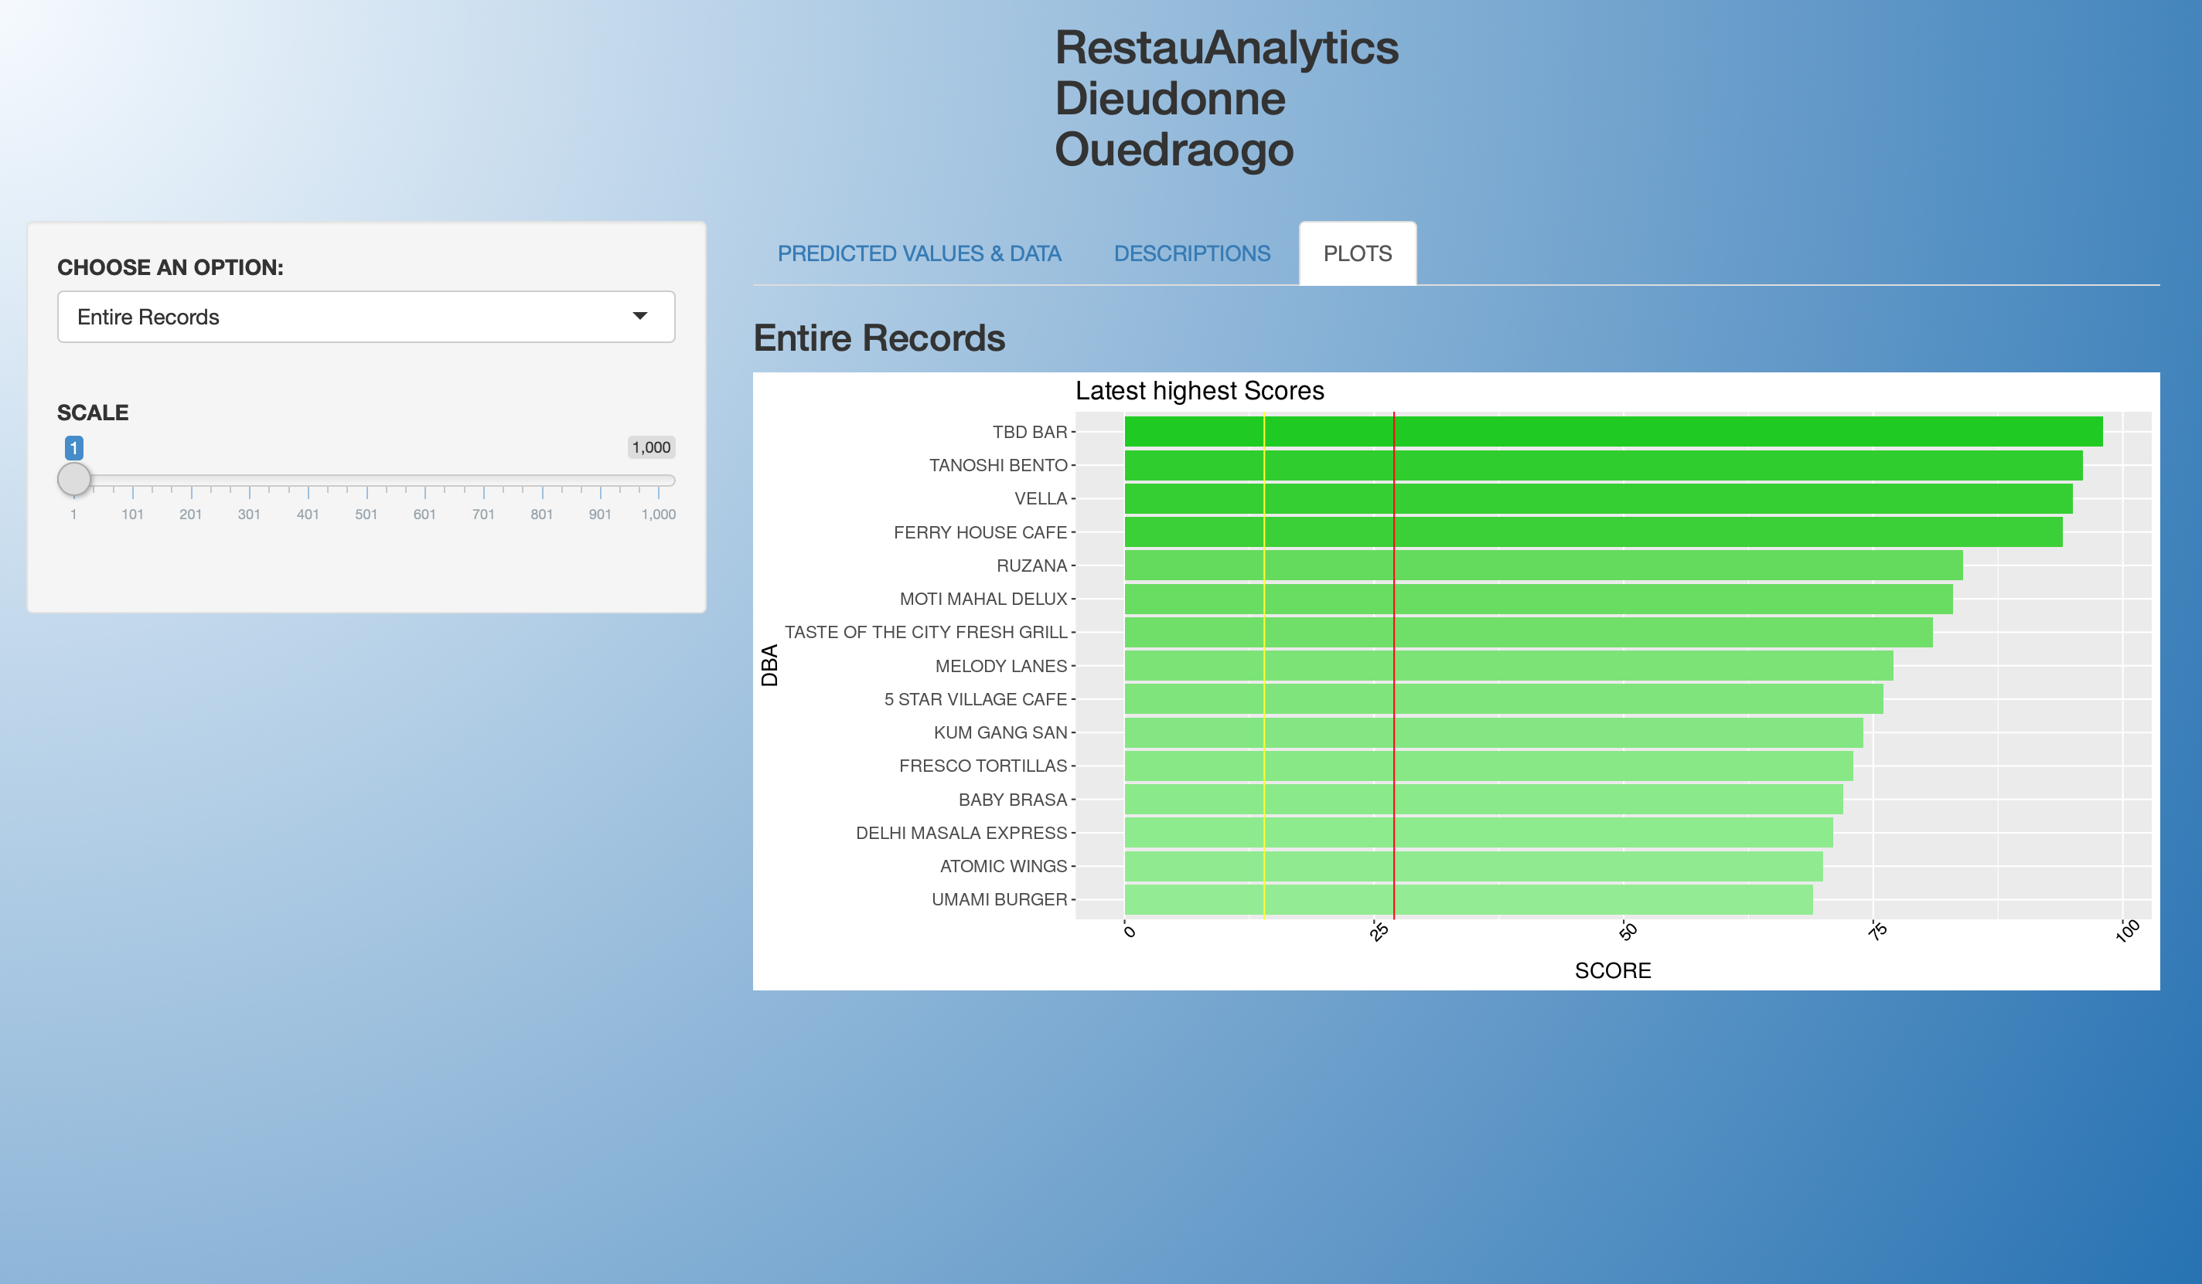

Slide 17
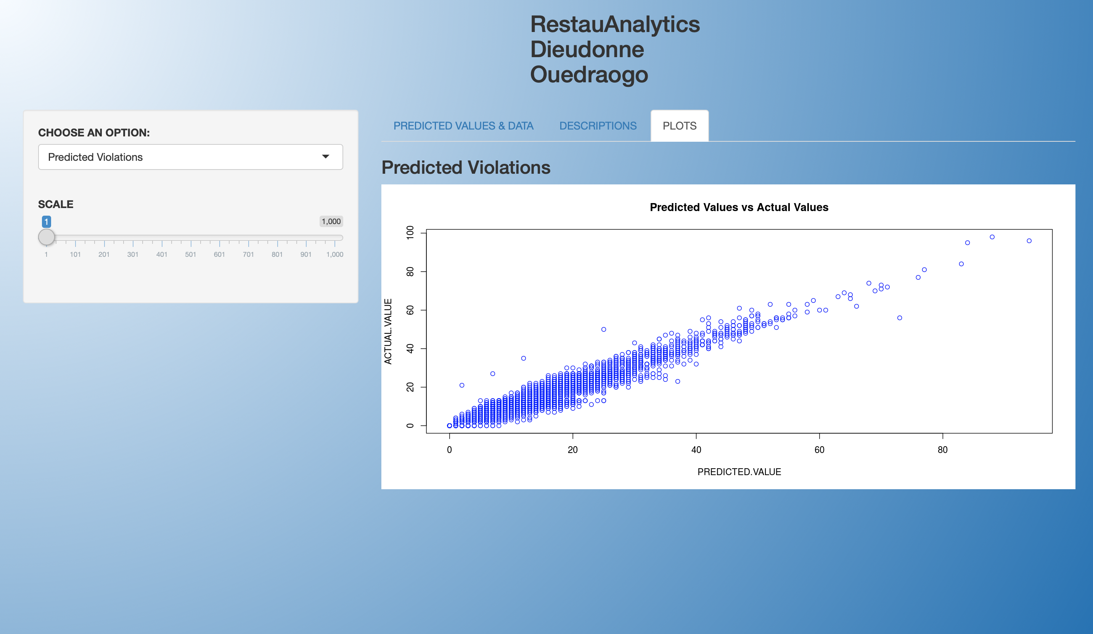
Screen Shot 2019-02-17 at 6.49.45 PM

Slide 18
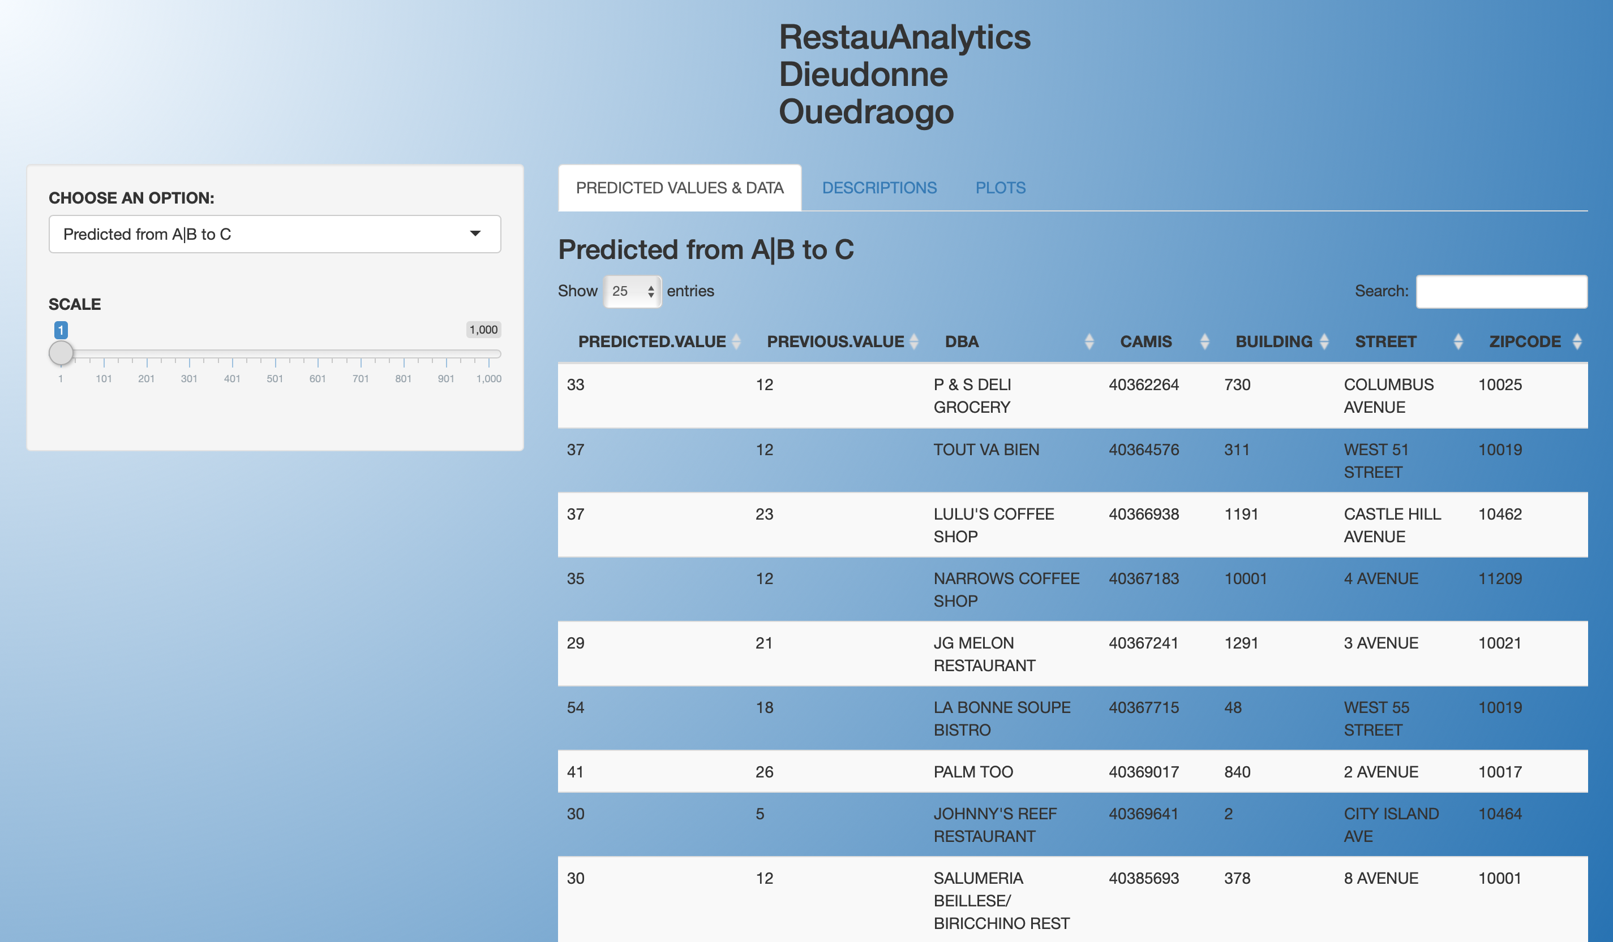

Slide 19
Conclusions
Machine Learning follows by a rule-based can help prioritize a random process and lead to better decision-making
Businesses can segment their customers or resources into groups and apply the same technique for better decision-making

Slide 20
About Me
Ph.D. Systems Science
Binghamton University Expected 2019
M.S. Data Analytics CUNY
B.S. Computer Science-Electrical Engineering University Cadi Ayyad

Slide 21

END
THANK YOU

Slide 22
Appendix

Slide 23
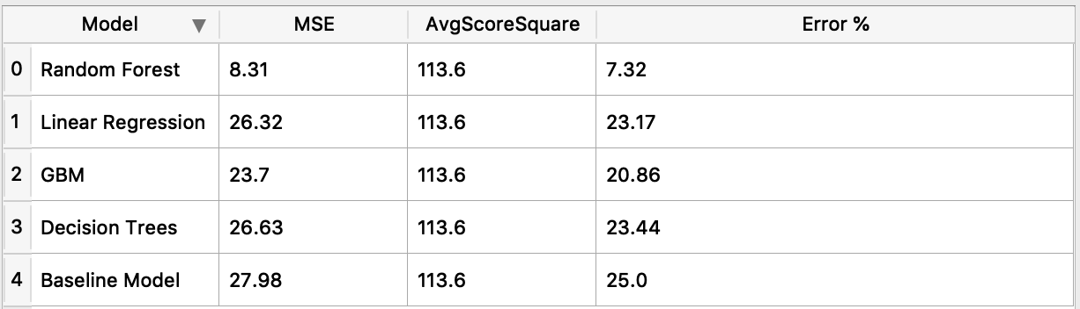
Mean Squared Errors

Slide 24
The Algorithm
Predict all future scores using Random Forest
Based on predicted score
Go through all observations
If restaurant is moving from Class A to class C :
retrieve observation
If restaurant is moving from B to C
retrieve observation

Slide 25
Choosing Random Forest
Correlated features, no overfitting, very noisy dataset with many missing values
Xgboost doesn’t perform well with noisy dataset and huge missing values
Why ordinal +RF better than time series: Too many missing values, irregular steps
Observations asynchronous
Distribution of time between inspections is random
how robust is your predictions: Very robust as it take the average of many trees predictions.

Slide 26
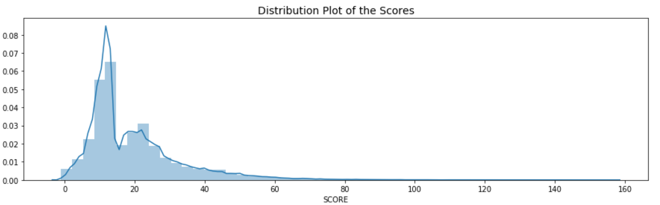
Distribution of score across restaurants

Slide 27
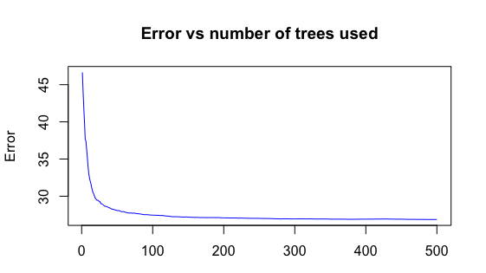
Error vs trees in Random Forest

Slide 28
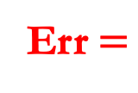
Predictions intervals
Err$=$
√
7.32
2.7
Prediction on the model are robust, the error is within 2.7

Slide 29
Grades in Borough

Slide 30
Most Frequents violations code
10F Non-food contact surface (53950)improperly constructed. Unacceptable material used. Non-food contact surface or equipment improperly maintained and/or not properly sealed, raised, spaced or movable to allow accessibility for cleaning on all sides, above and underneath the unit.
08A Facility not vermin proof. (41553) Harborage or conditions conducive to attracting vermin to the premises and/or allowing vermin to exist
04L Evidence of mice or live mice (28100) present in facility's food and/or non-food areas

Slide 31
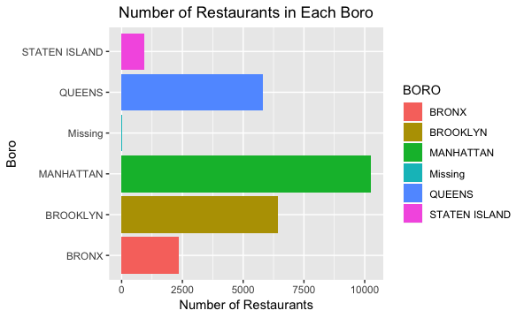
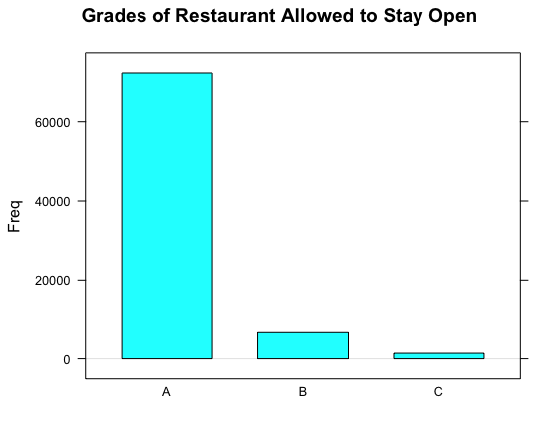
Grades & Restaurants

Slide 32
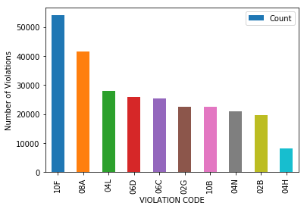
The 10th highest violation codes

Slide 33
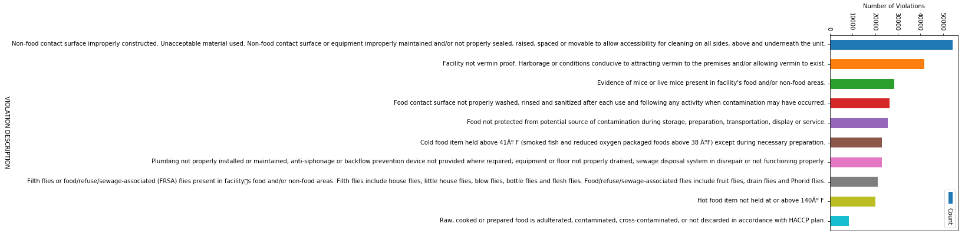
Violations

Slide 34
Reference
https://www.nytimes.com/2018/06/05/dining/new-york-restaurant-inspections-by-the-numbers.html
26,101 Restaurants subject to New York City health department inspections (as of December 2017)
40,700 Total inspections (in 2017)
About 100 Restaurant health inspectors today
22,185 Restaurants with A grades (in April)

Slide 35
Records
1,256 Restaurants with Bs
315 Restaurants with Cs
1,019 Restaurants closed because of unsanitary conditions (in 2017)
4,670 Restaurants with violations, at most recent inspection, related to mice (as of December 2017)
1,325 Restaurants with violations, at most recent inspection, related to cockroaches
About 22,600 Restaurant supervisors completing health department food-protection course in 2010, when letter grading began

Slide 36
Inspections Timeframe
If you receive 14-27 points, on either the initial or re-inspection you will be on a 150-210 day cycle
01
If you receive 28 or more on either the initial or re-inspection, you will be on a 90-150 day cycle.
02
However a score of 28 or more on the re-inspection will have an additional compliance inspection that will not lead to changing the letter grade or cycle.
03

Slide 37
CRITICAL VIOLATION
Food Temperatures
Improper Cooking is a 10 or 28 point violation only. 10 points if they find it; 28 if it is not Corrected During the Inspection
Improper Hot Holding 5-8 points based on the number of foods in violation
Cold holding above 41°F for most foods includes garlic in oil, or above 38°F for ROP foods and smoked fish
Foods prepared from ambient ingredients below 41°F in 4 hours or less

Slide 38
Critical violation
Food Sources
01
Dirty or cracked eggs, ranging from 1-25 by groups of 6, points of 7-28
Food Protection
02
Three compartment sinks will be needed in all facilities
Closed drink containers are not allowed to contaminate the food stream.
Wet cloths in sanitizer at the proper concentration and test strips are available
Presence of vectors and evidence of vectors in varying degrees ranging from 5-28 points

Slide 39
Critical violations
Facility Design
Overhead dust and dirt that could contaminate foods
Sneeze guards, wrapped portioned products
Proper thermometers or thermocouples
Food contact surfaces constructed, located or unacceptable materials
Food contact surfaces are to be WASHED RINSED and SANITIZED in place after each use
Personal Hygiene
Ill employees will be worth 10 points and failure to remove them will result in 28 points
All employees working with ready to eat foods are using gloves
Improper hand washing
There is a sliding scale that increases the points associated with the violations, ranging from 5-28 points.

Slide 40
The methodology part 1
Group data by restaurants ID
Within a restaurant
Index each score position with n
Retrieve the score into a variable Vn
At the end restaurants will have different numbers of inspections
Pick the maximum number of inspections which is in this case 33
Order scores by inspection date
Do the same for all the restaurants

Slide 41
Methodology part 2
Since restaurants don’t have the same number of inspections, there will be missing values.
I decided to keep the entire dataset and to impute the missing values by the row average of the restaurant own score.
To preserve the order of inspections, inspections scores should moved to the right if there are missing values in a row
Do the imputation of the missing values.

Slide 42
Methodology part 3
To be able to measure the effectiveness of the process, we will use the last inspection V33 as the target, and use the scores V1 to V32 as input variables, but once the model is built and well tested, we plug V2 to V33 as inputs to the predict the next score.
Use the rule-based step to retrieve the values of high priority

Slide 43
END
THANK YOU

